Slide 1
Garbage Bot
MAYANK BHARTI-210003046
M. ARHAM AZAM-210003047
RAJNESH MEENA-210003061
SAURABH SHUKLA-210003067
VINAY DESAI-210003084

Slide 2
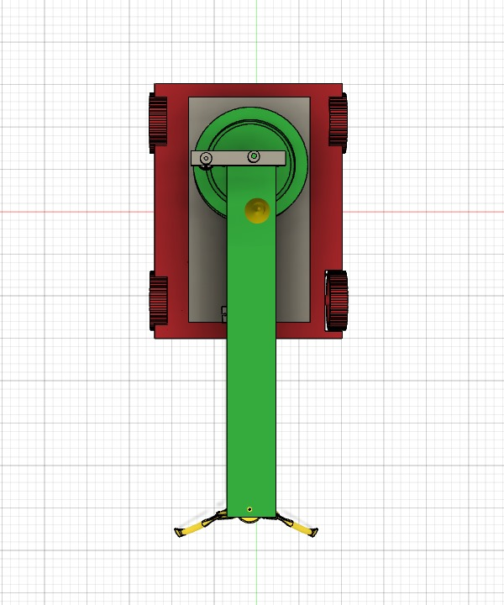
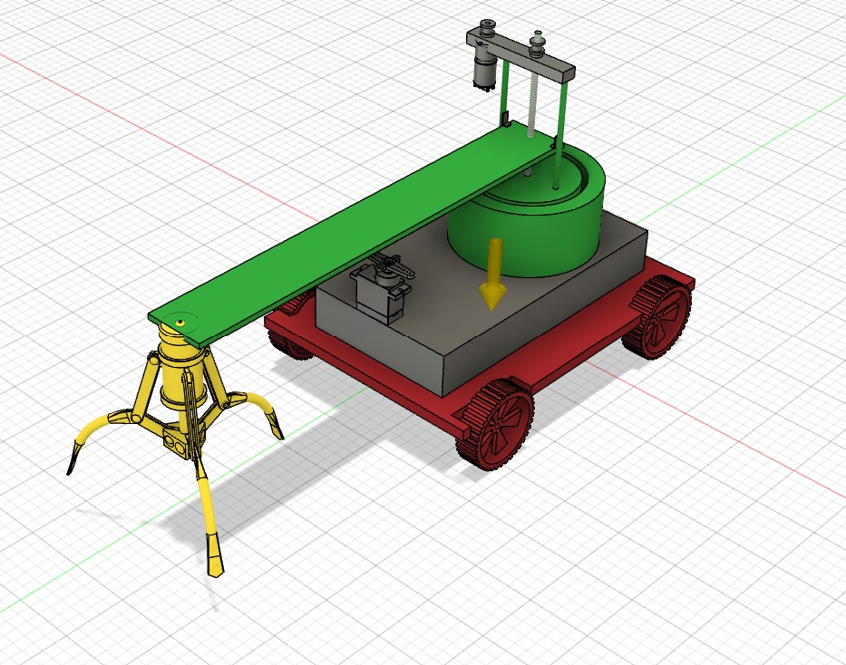
Design

Slide 3
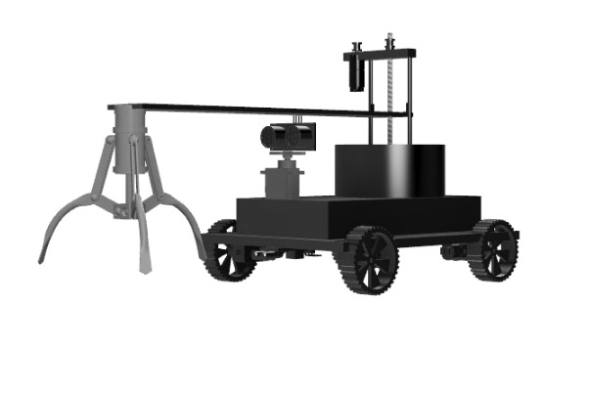
Model

Slide 4
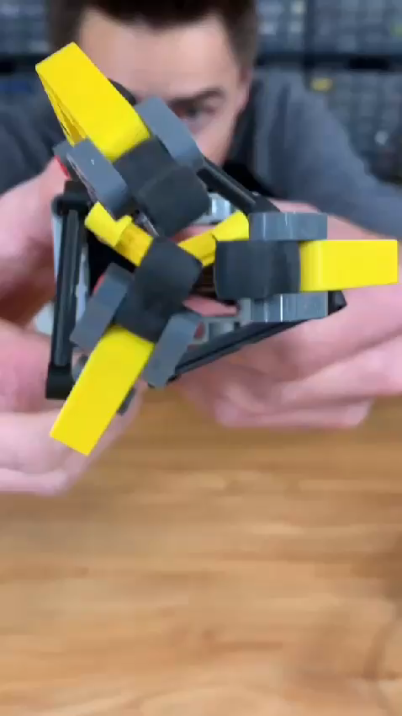
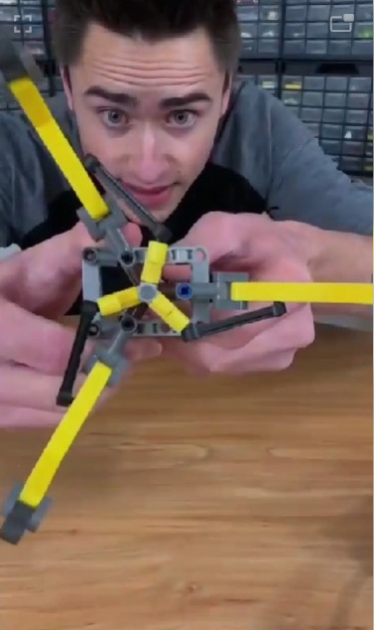
Mechanisms:

Slide 5
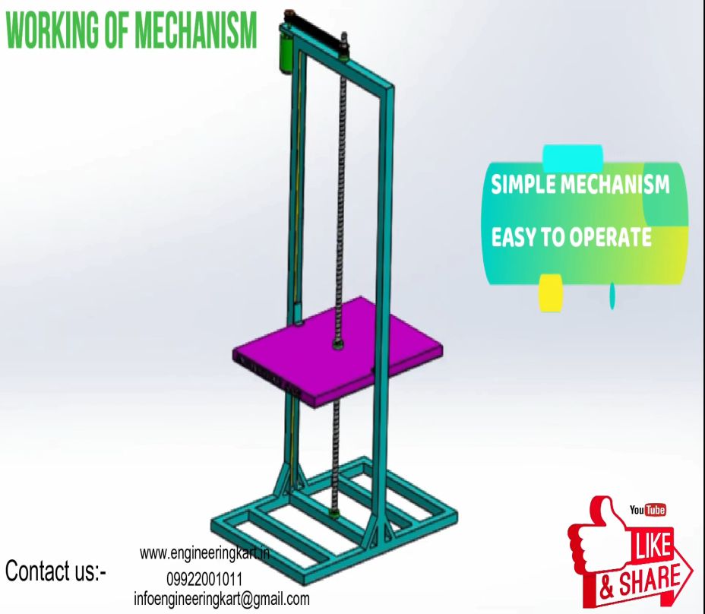

Slide 6
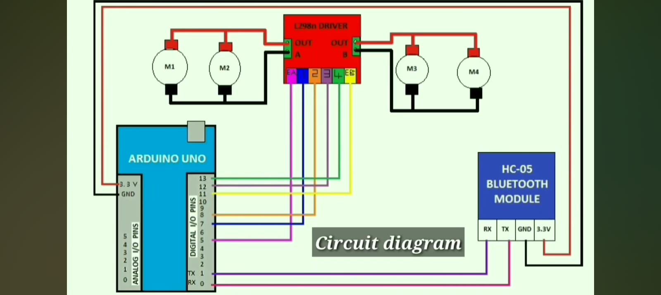
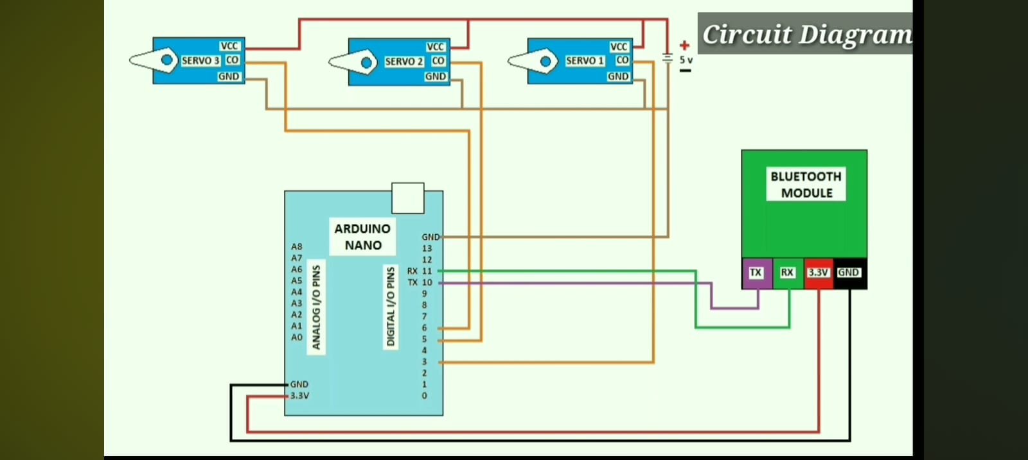
Simple Circuit Diagram :

Slide 7
Uses :-
It can be used to clean garbage(e.g. Water bottles, Cans, wrappers, etc.) in :
Gardens
Grounds
Amusement Parks
Beaches

Slide 8
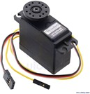
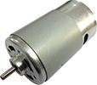
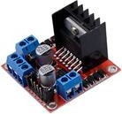
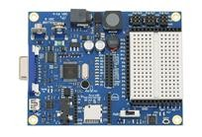
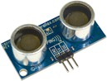
Materials
Component | Quantity | Price (Rs)
Arduino UNO | 1 | 280
BO Gear Motor & Wheels | 4 | 200
Servo Motor | 3 | 360
Infrared Sensor | 1 | 25
Ultrasonic Sensor | 1 | 50
DC Motor | 1 | 40
Motor Driver Board | 1 | 125
Battery (6V) | 1 | 250
Arduino NANO | 1 | 215
Bluetooth Module | 1 | 280

Slide 9
THANK YOU

